Slide 1

Newquay Zoo Walk through
A resource for teachers with SEN learners

Slide 2
A Note for Teaching Staff
How to use this power point
In this PowerPoint we have included various different aspects of a day at the zoo.
It is designed to be fully editable so you can tailor it to your day.
Some parts may not be applicable to your visit, you can hide the slides that do not apply (including this one).
On some slides there are various options shown, you are welcome to delete and enlarge pictures where appropriate if you wish to do so.
You can find what's applicable to your visit by looking at the itinerary that will be emailed to the school up to 2 weeks before your visit.
Please be advised that although we do our very best to stick to the plan, sometimes things happen out of our control and we may need to change them.
We hope you find this PowerPoint useful, we are always open to suggestions on how we can make it better.

Slide 3
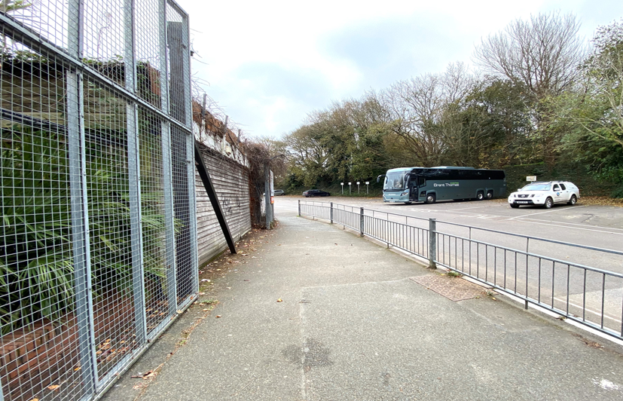
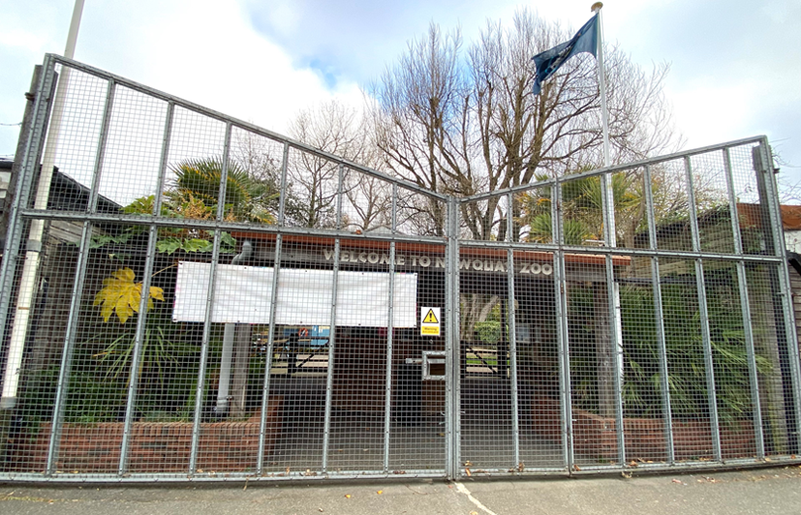
Arrival
When you arrive at the zoo your coach or minibus will park in the car park near the front entrance of the zoo.
The zoo gates open at 10 o’clock in the morning.

Slide 4
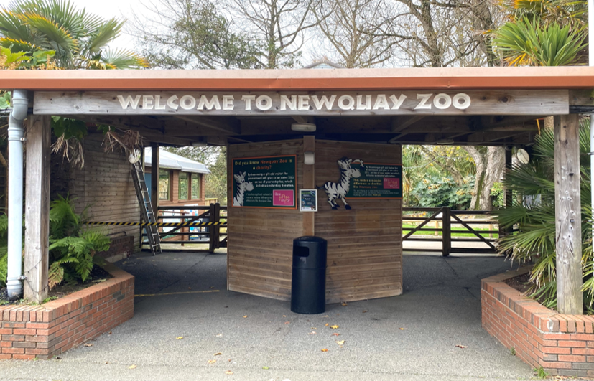
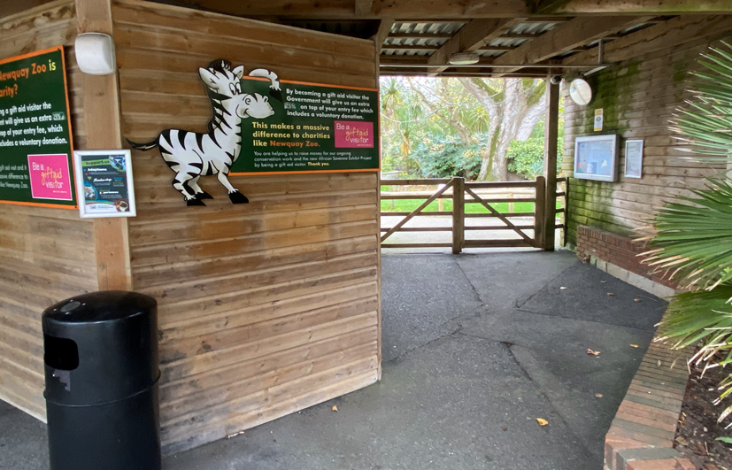
Here is the main entrance, it can sometimes be busy with people visiting for the day.
One of our educators will meet you here and take you into the zoo.

Slide 5
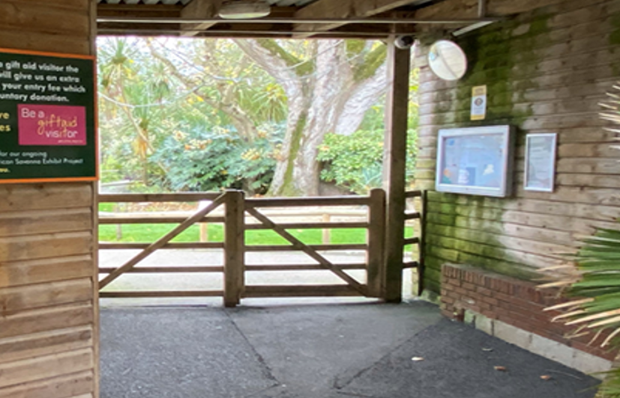
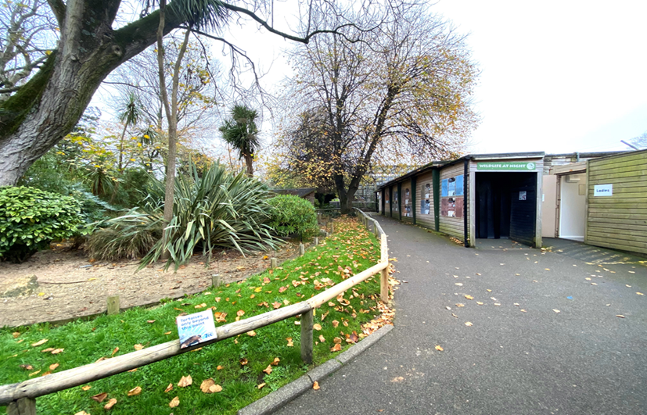
Follow our educator through the gate...
Past the tortoise enclosure.

Slide 6
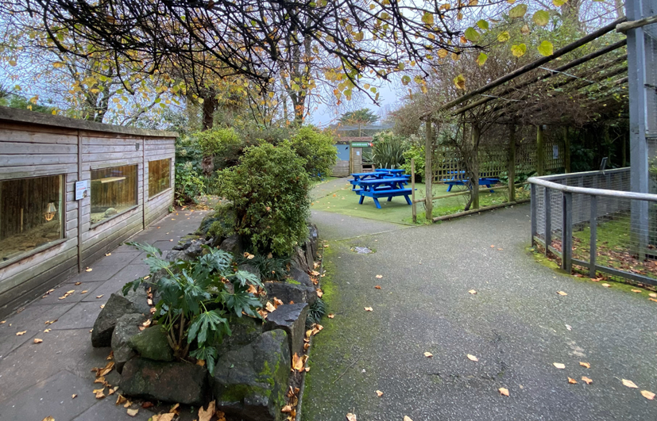
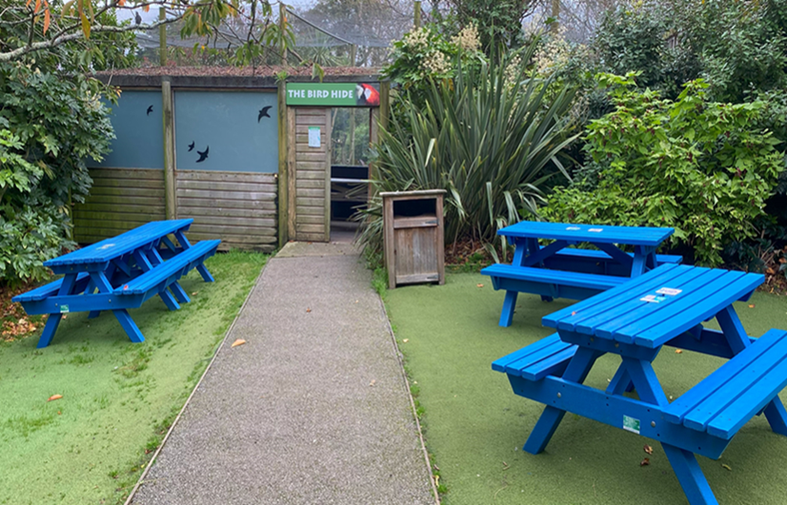
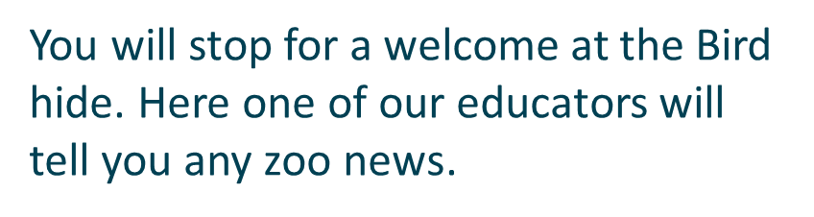
Continue past monkey walk.

Slide 7

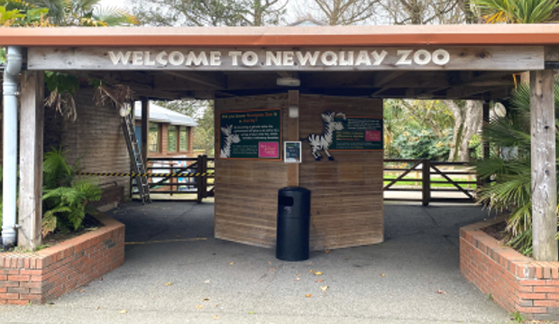
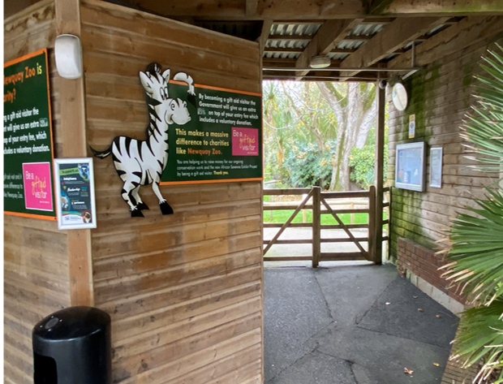
Self led Arrival (for groups smaller than 10)
When you arrive at the zoo, your coach or minibus can park in the zoo car park.
Here is the main zoo entrance, it can sometimes be busy with people queueing to visit the zoo.
Walk through the gates to enter the zoo.

Slide 8
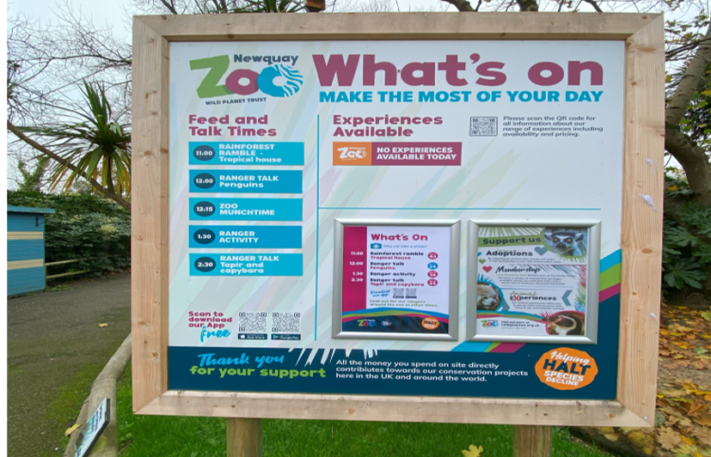

Noise Note.
You will hear tannoy announcements across the site about feeds and talks that are happening. Our lemurs like to respond to these announcements with loud calls.
You will see our what’s on board near the entrance.

Slide 9
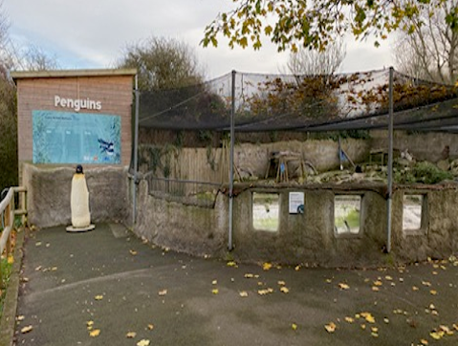
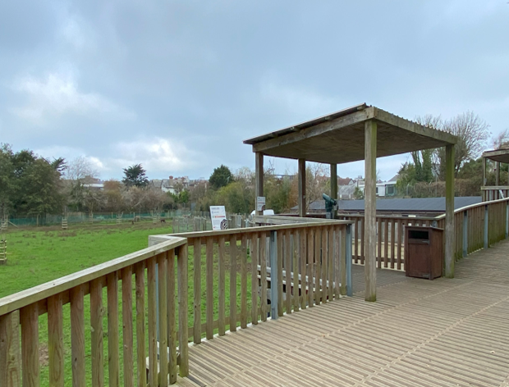
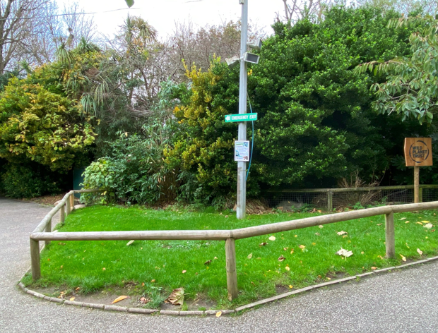
Mini session location
If your group is taking part in a mini-session, one of our educators will meet you at an enclosure, tell you some interesting facts, and show you some artefacts.
Penguins
Savanna
Tropical House Lawn

Slide 10

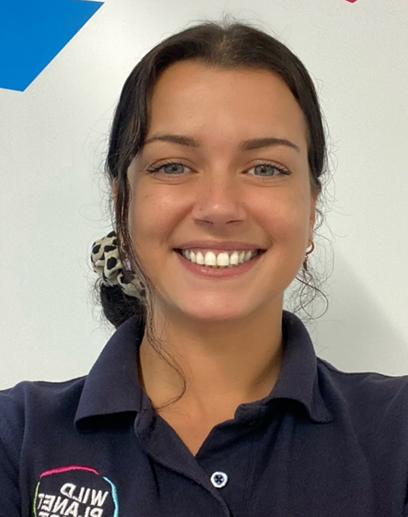

Here are our educators…
Mark
Rhiann
Emma

Slide 11
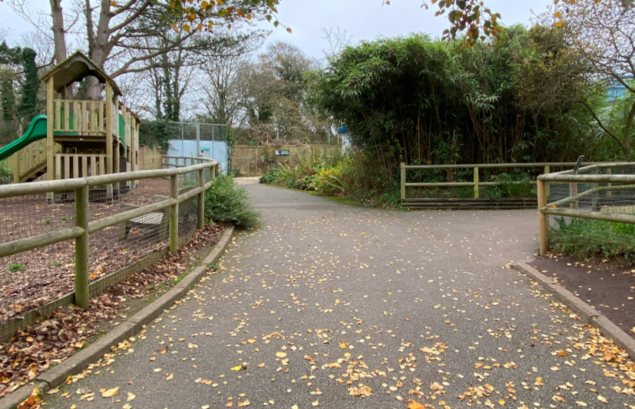
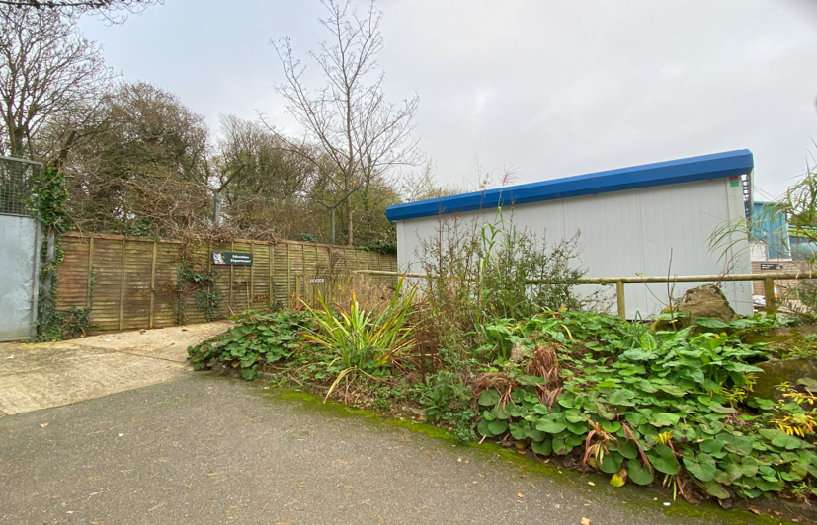
Workshops
If you are attending a workshop, you will visit our Classroom.
.
This is the path to the Education Centre.
Follow the path to the top.

Slide 12
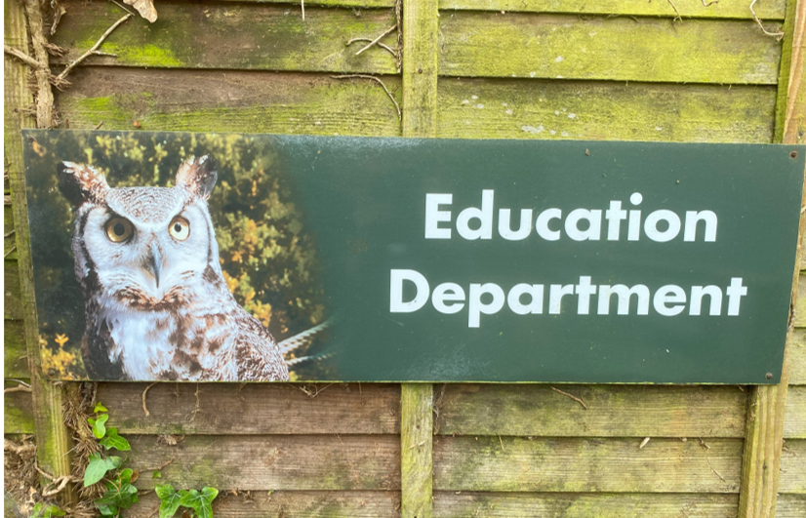
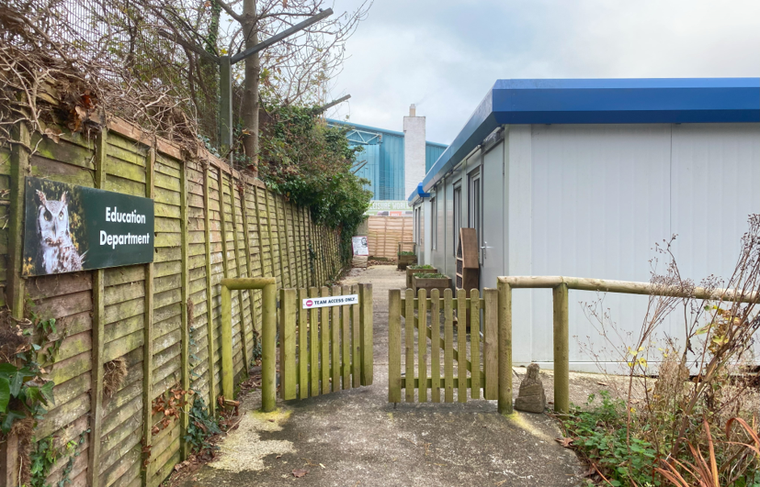
Look out for this sign.
One of our educators will meet you here.

Slide 13
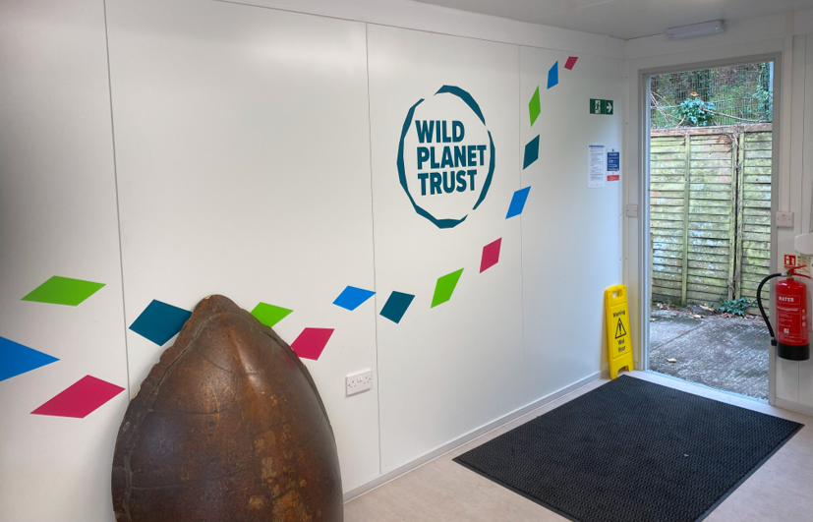
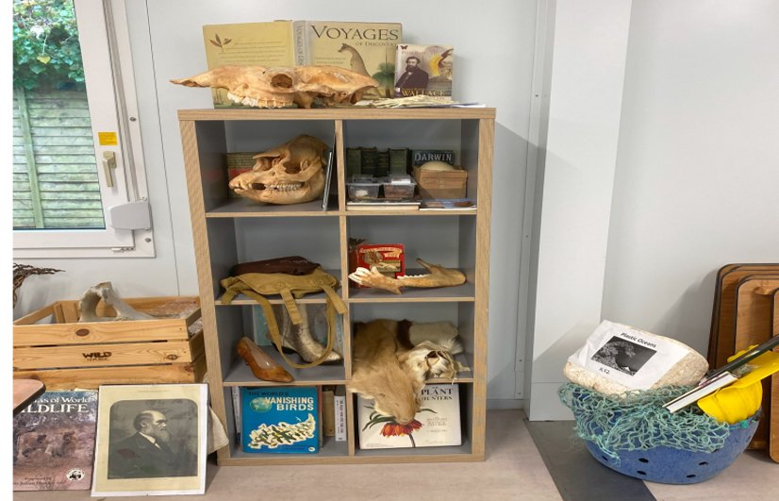
This is inside our classroom. You will sit down on the floor or chairs to start.
There are lots of different artefacts and resources to explore during the workshop.

Slide 14
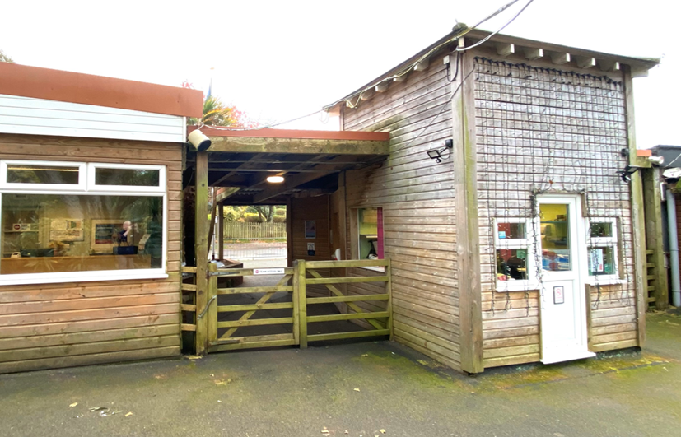

Departure
(Avoiding gift shop).
You can leave the zoo the same way that you came in.
You will then be in the car park where your coach or mini bus is waiting.

Slide 15
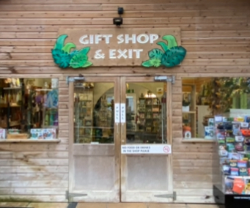
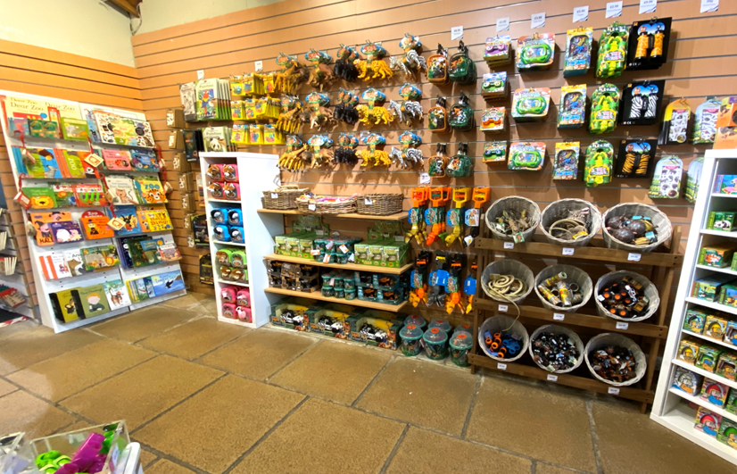
Departure
(Including gift shop)
This is the entrance to the gift shop. You can exit the zoo, by going through the gift shop.
This is the entrance to the gift shop. There are lots of things to look at and that you can buy.

Slide 16
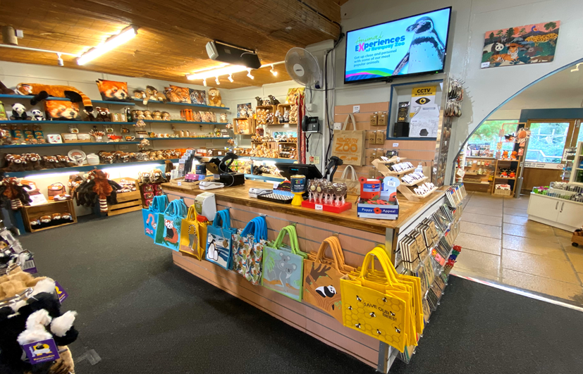
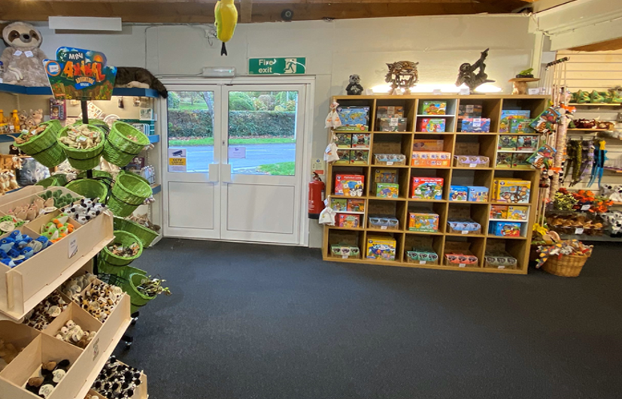
You pay for your things at these tills.
To leave the shop and zoo, walk through this door.

Slide 17
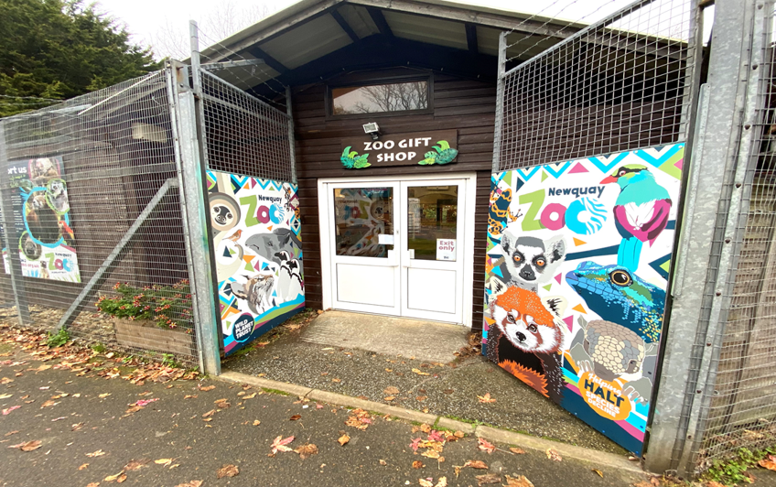

You will exit the zoo here.
You will then be in the car park where your coach or mini bus is waiting.

Slide 18
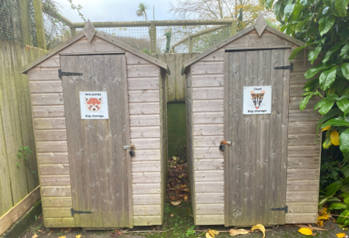
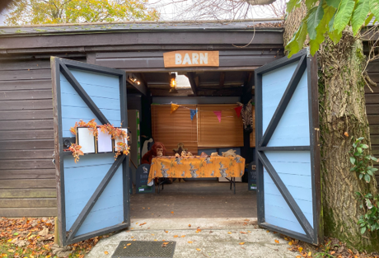
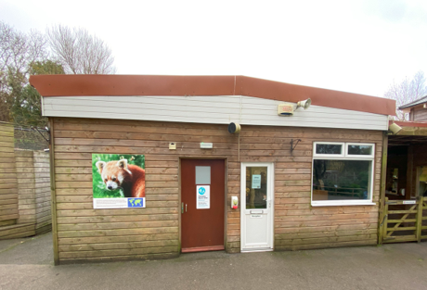
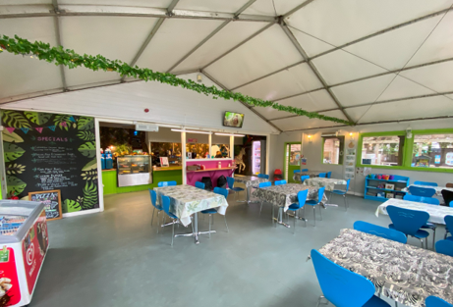
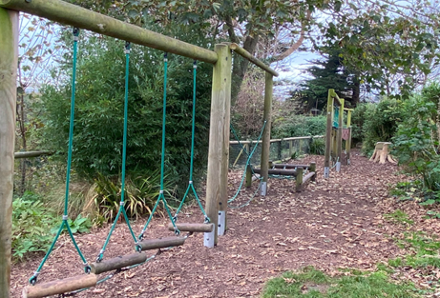
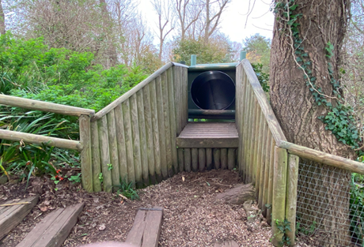
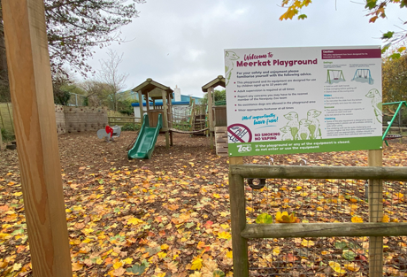
Other places you may visit
Bag storage
Ranger activities
Main office
Café lemur
Tarzan trail and big slide
(Stepped access)
Meerkat play area

Slide 19
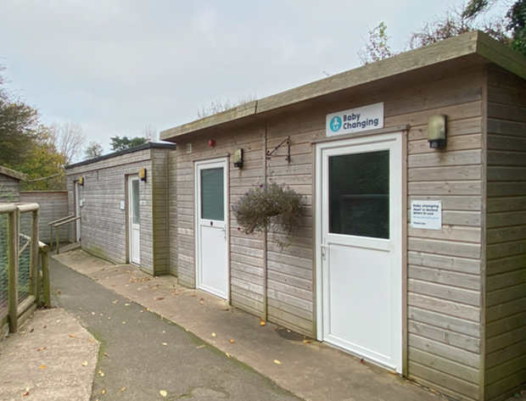
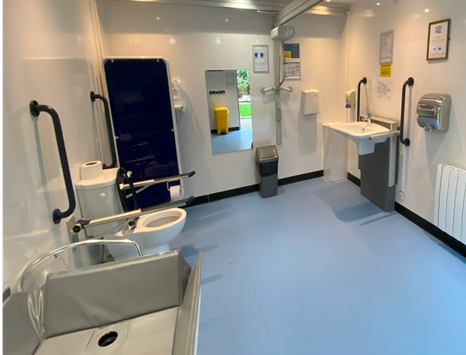
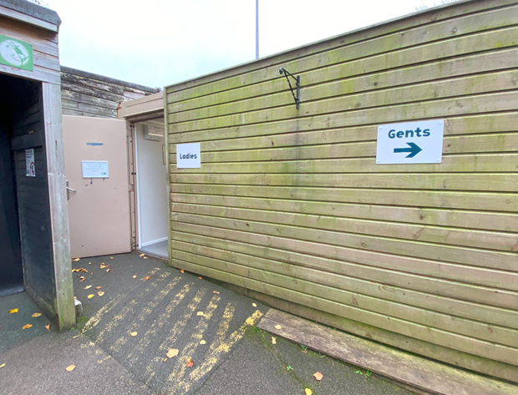
Toilets
Near the meerkats
Changing places accessible toilet. Collect the key from the office.
Near the entrance
.

Slide 20

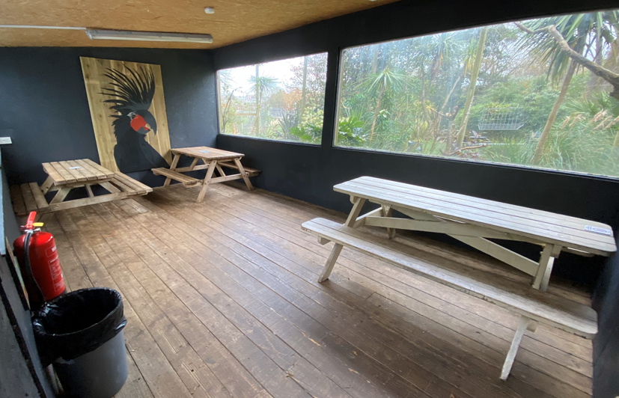
Lunch Space
Outside the bird hide
Inside the bird hide
Our lunch space provide somewhere dry for you to eat your lunch
If we are busy, you might have to share with another school.

Slide 21
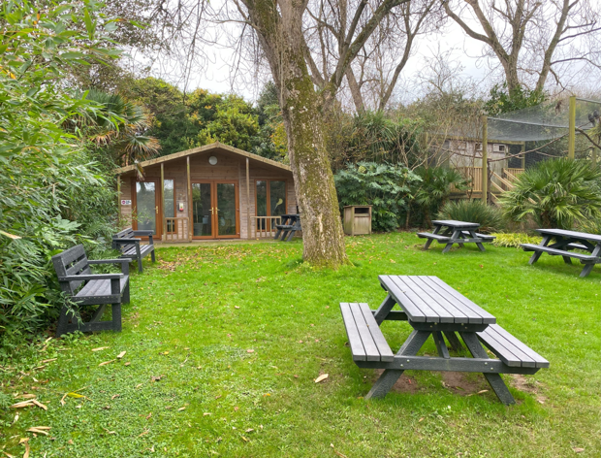
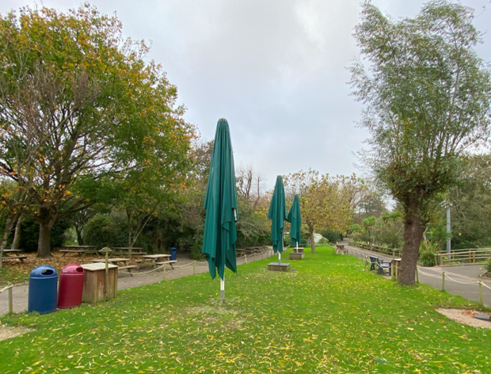
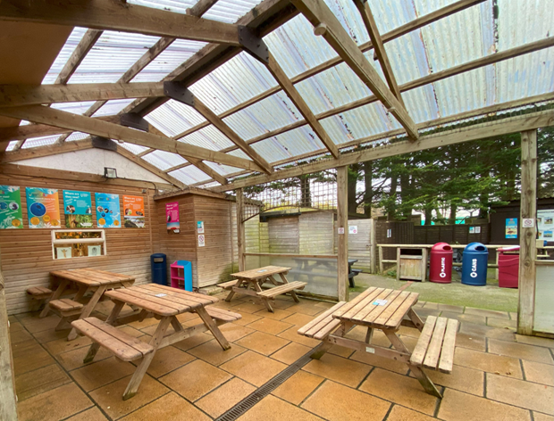
Picnic areas around the Zoo
(not reserved – shared with visitors)
Red Panda lawn
Lawn and picnic tables near Penguins / Tippy’s Café
Café Patio – if wet

Slide 22
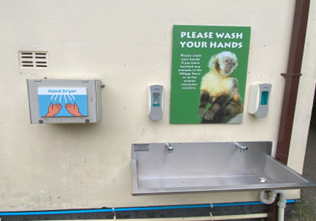
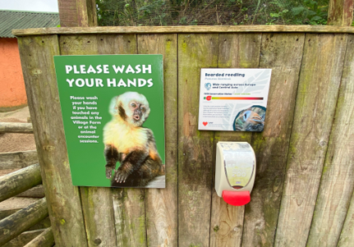
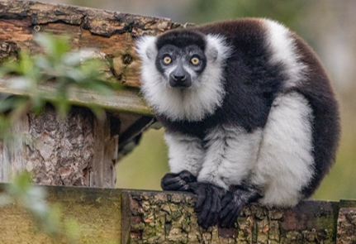
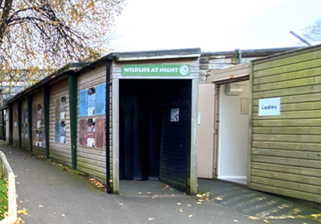
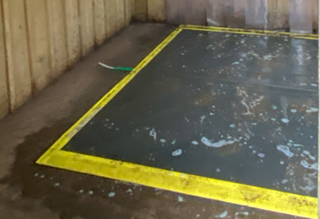
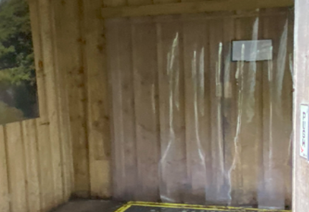
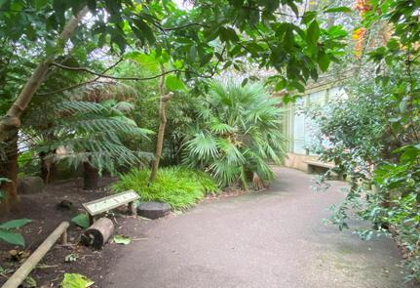
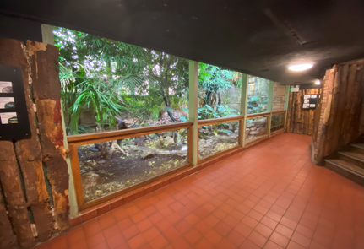
Good to know
Areas with additional sensory triggers
Noisy hand dryers at hand wash facilities.
Noisy lemurs
Low light level
Shoe wash mats
(Gems of the jungle and tropical house)
Plastic strip curtains
(Gems of the jungle, tropical house and wildlife at night).
Free flying birds
(Gems of the jungle and tropical house)

Slide 23








Some of our animals

